Slide 1
Comprehensive Digital Marketing Project Work

Slide 2

Part 1: Brand study, Competitor Analysis & Buyer’s/Audience’s Persona
COMPANY/TOPIC for the project : HAVELLS INDIA LIMITED
Research Brand Identity: Study the brand's mission, values, vision, and unique
selling propositions (USPs).
Brand Colour:
Red and white
LOGO:
Mission/Values:
To achieve our vision through business ethics, global reach, technological expertise, building long-term relationships with all our associates, customers, partners and employees.
Energy efficiency and cost-effectiveness.
USP:

Slide 3
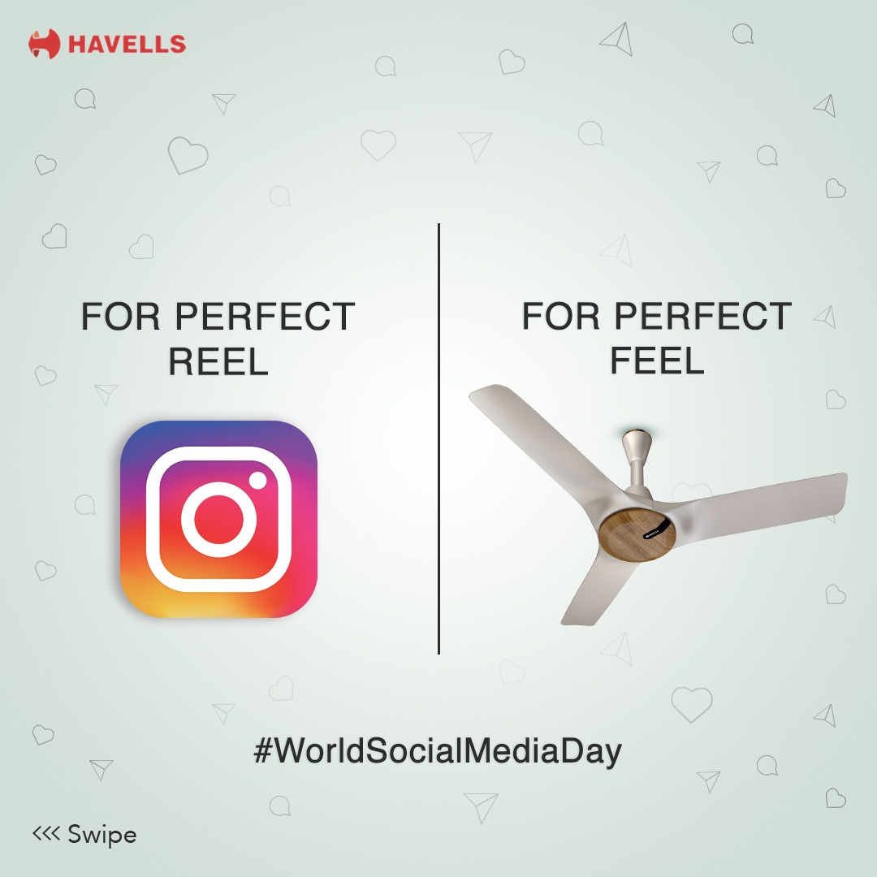
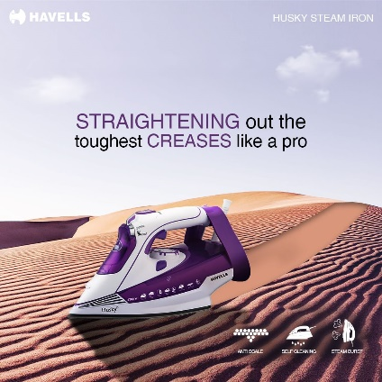
Part 1: Brand study, Competitor Analysis & Buyer’s/Audience’s Persona
COMPANY/TOPIC for the project : HAVELLS INDIA LIMITED
Brand Messaging : Funny and Informative,
incredible innovations
https://www.instagram.com/p/CuGXeHPIByt/?igshid=MzRlODBiNWFlZA==
https://www.instagram.com/p/CuHOZK1oyi3/?igshid=MzRlODBiNWFlZA==
Tagline : committed to save energy

Slide 4
Part 1: Brand study, Competitor Analysis & Buyer’s/Audience’s
Persona
Competitor Analysis: Select three competitors operating in the same industry or
niche as the chosen brand, examine their USPs and online communication.
Competitor 1: Exide Industries
https://www.exideindustries.com/
USP :Superior customer service and warranty.
Online Communication : Provide toll free number and chat box
CG Power and Industrial Solutions
Competitor 2:
https://www.cgglobal.com/
USP :
Online Communication :
CG is an engineering conglomerate with an impressive and diverse portfolio of products, solutions and services for Power and Industrial equipment and ...
Provide official website URL and chat box
Competitor 3:
Bajaj Electricals
https://balajielectricalandelectronics.com/
USP :We are reputed service provider for Home Electronics & Appliances Dealers, AC Dealers, DVD in Pune. We are a proprietorship company and is known to be a ...
Online Communication: Provide contact number and email id

Slide 5
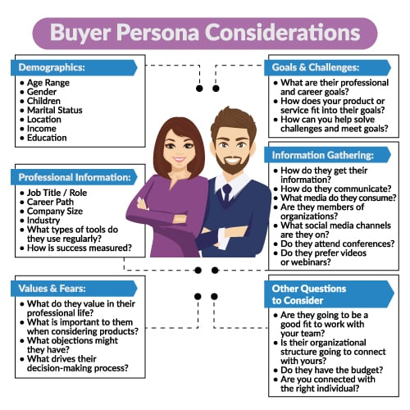
Part 1: Brand study, Competitor Analysis & Buyer’s/Audience’s Persona
Buyer's/Audience's Persona: Clearly define the target audience for the chosen
brand. Consider demographics, psychographics, behaviors, and interests.
HAVELLS INDIA LIMITED
Demographics :
Age Range : All Age Groups
Gender : All
Marital Status : Both (married/unmarried)
Location : All Over India
Income : 2,00,000
Education : At least 10
Information Gathering :
How do they get their information :
Community Platform, Youtube ads, Facebook and Instagram ads
Value & Fears :
What do you they value in their professional life :
A commitment to surpass our customer expectations
A commitment to set standards for our business and transactions based on mutual trust.

Slide 6
Part 2: SEO & Keyword Research
SEO Audit: Do an SEO audit of the brands website
Keyword Research: Define Research Objectives, Brainstorm Seed Keywords, Utilize Keyword Research Tools (SEMrush or Moz Keyword Explorer),Analyze Competitor Keywords, Long-tail Keyword Exploration (specific, longer phrases) that align with the research objectives and have lower competition but higher conversion potential.
On page Optimization: Meta Tag optimization & content optimization
Reflect on the process of conducting keyword research and the SEO recommendations
provided.
Document the challenges faced during the research and analysis phase, as well as the key
insights gained from the keyword research process.

Slide 7
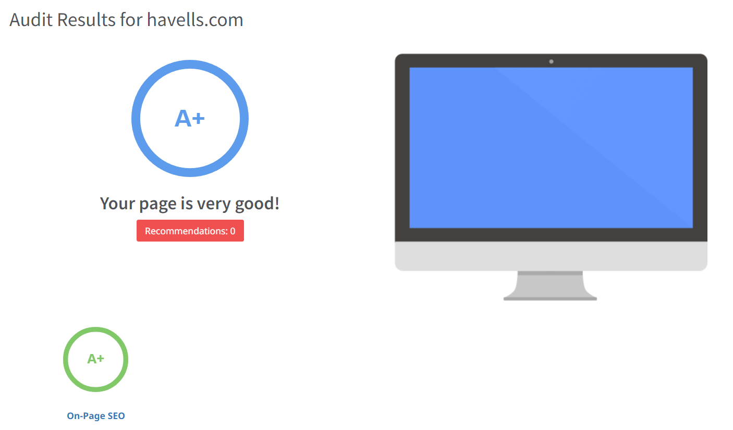
Summary :
Search engine optimization (SEO) is the practice of orienting your website to rank higher on a search engine results page (SERP) so that you receive more traffic.

Slide 8
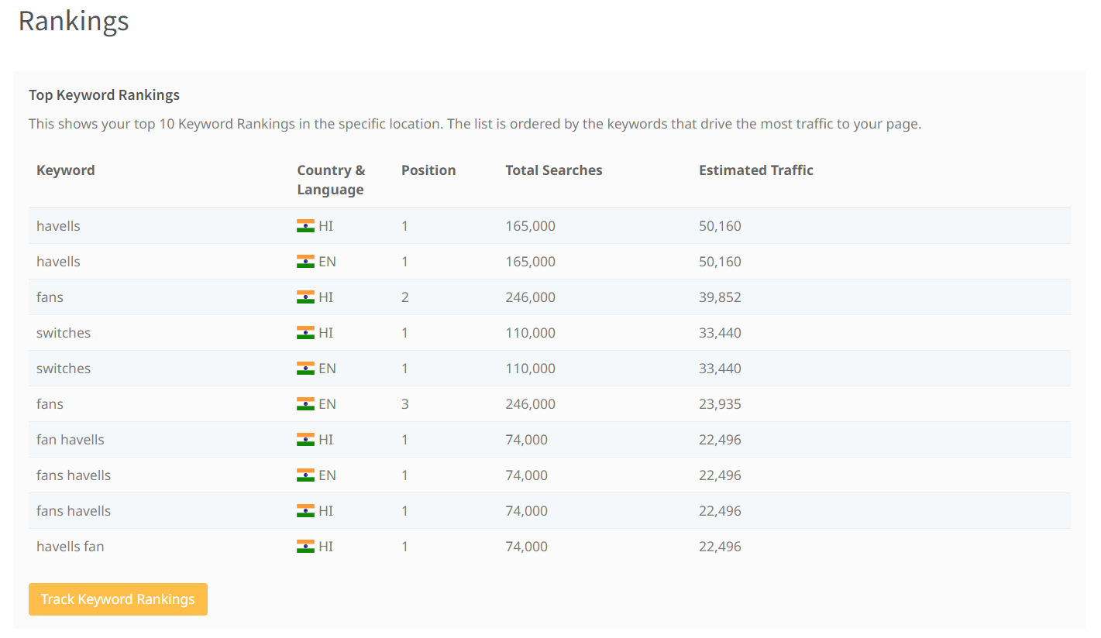

Slide 9
keywords : Home appliances
home appliances | 50000 | Medium
induction cooker | 50000 | High
micro oven | 500000 | High
Meta Title
find the Best home appliances and products 58
Meta Description
buy new home appliances and products in the very safety and useful 74
keywords : Grooming
grooming | 50000 | Low
lg air conditioner | 5000 | High
best air purifiers | 5000 | High
Meta Title
find the Best grooming products 52
Meta Description
buy new grooming products and which can use is very easy and safe 73

Slide 10
keywords : Water Purifier
water purifier for home | 50000 | High
water dispenser for home | 500 | High
water coolers | 50000 | High
Meta title
Havells brands is always special in making purifiers 48
Meta description
Havells is always a brand mark for making water purifier and protect the people. 72
keywords : Electric Appliance
electric appliances | 50000 | Low
electric fan heater | 500 | High
electric air conditioner | 500 | High
Meta title
Havells is the always making the new electrical appliance 70
Meta Description
Havells is the always making a best electrical and products it is very reasonable cost 71

Slide 11
keywords :House Appliances
house appliances | 500 | Low
home ice machine | 50 | High
fruit juicer machine | 5000 | High
Meta title
Try house appliances feel awesome than before to maintain a healthy life 60
Meta Description
buy home appliances and to try this type of product and can make easy to the prepare the juices and home food items 122

Slide 12
Part 3: Content Ideas and Marketing Strategies
Content Idea Generation & Strategy: Create a content calendar for the remaining month of July by brainstorming content themes, exploring various formats like blog posts, videos, infographics, podcasts, and interactive quizzes, and scheduling publication dates mainly on Facebook & Instagram.
And include the strategy, aim and the idea behind these posts and story
Content Calendar Example (Try creating a table for the month of July)

Slide 13
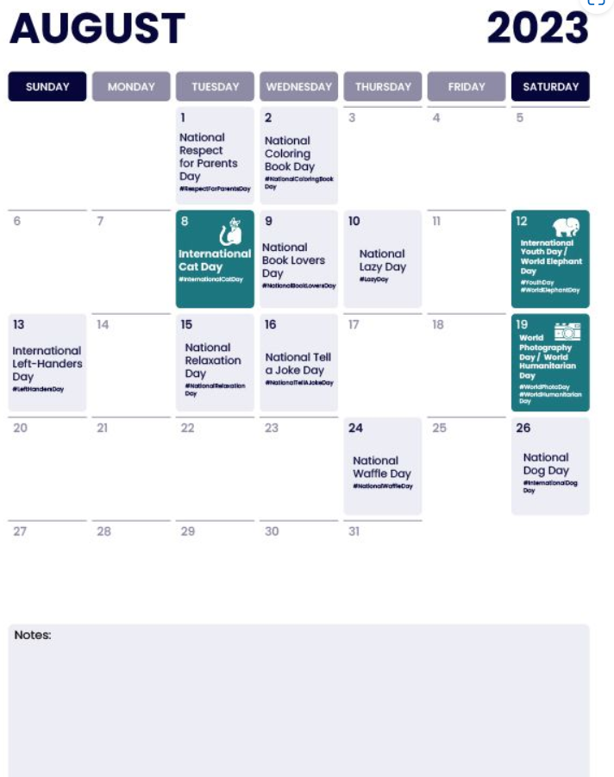
Part 3: Content Ideas and Marketing Strategies
Content Idea Generation & Strategy: Create a content calendar for the remaining month of July by brainstorming content themes, exploring various formats like blog posts, videos, infographics, podcasts, and interactive quizzes, and scheduling publication dates mainly on Facebook & Instagram.
And include the strategy, aim and the idea behind these posts and story
Content Calendar Example (Try creating a table for the month of July)

Slide 14
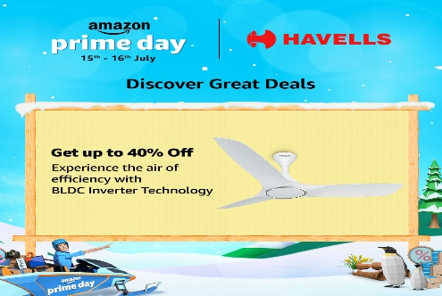
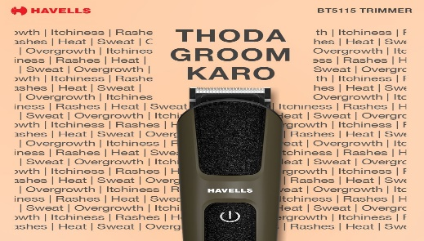
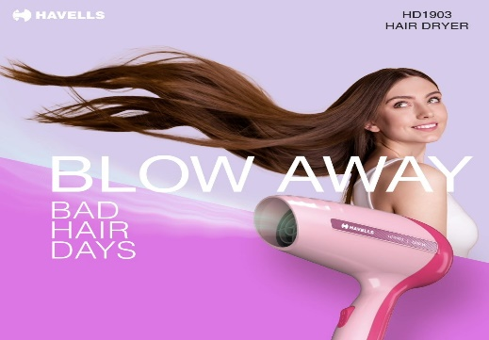
Part 3: Content Ideas and Marketing Strategies
Date : 17th august 2023
To promote newly launched electronics and home applicants. Havells India limited has launched new electronics and home applicants
Date : 18th august 2023
Havells all products to reach everyone. Havells India Limited has launched new electrical products to use everyone.
Date : 21st august 2023
To promote the Havells products. Created a meme about Havells

Slide 15
Part 3: Content Ideas and Marketing Strategies
Creating content ideas and devising effective marketing strategies is a dynamic process that involves continuous learning and adaptation. Throughout this journey, several challenges and valuable lessons can be encountered. 1.Understanding the Audience: One of the primary challenges is comprehending the target audience's preferences, needs, and pain points. 2. Generating Unique Ideas: Coming up with fresh and innovative content ideas can be difficult, especially in saturated markets. 3. Consistency and Quality: Maintaining a consistent flow of high-quality content can be demanding. Setting up an editorial calendar and adhering to a content creation schedule helps in maintaining quality and meeting deadlines. 4. Content Promotion: Even the best content may not gain traction without proper promotion. Crafting effective marketing strategies to reach the target audience across various channels is crucial for success. 5. Collaboration: Collaborating with influencers or other brands can amplify the reach of content and strengthen marketing efforts. The content ideas and marketing strategies process is an iterative and learning-oriented journey

Slide 16
Part 4: Content Creation and Curation (Post creations, Designs/Video Editing, Ad Campaigns over Social Media and Email Ideation and Creation)
Post Creation:
Select Content Categories: Identify three different content formats relevant to the chosen topic or industry. Research and Brainstorm: Research trending topics, industry news, or audience interests within each category. Brainstorm ideas for social media posts that align with each category. Do note that 1 content format has to be video and additionally 3 stories/status are to be created.
Format 1 Blog Article
Format 2 Video
Format 3 Creative

Slide 17

Part 4: Content Creation and Curation (Post creations, Designs/Video Editing, Ad Campaigns over Social Media and Email Ideation and Creation)
Format 1 Blog Article
Aim : To promote newly launched electronics and home applicants
Date : 17th august 2023
Idea : Havells India limited has launched new electronics and home applicants
Topic : Electronics and home applicants :

Slide 18

Part 4: Content Creation and Curation (Post creations, Designs/Video Editing, Ad Campaigns over Social Media and Email Ideation and Creation)
Format 2 Video
Aim : Havells all products to reach everyone
Date : 18th august 2023
Idea : Havells India Limited has launched new electrical products to use everyone
Topic : Electrical products for Havells India Limited

Slide 19
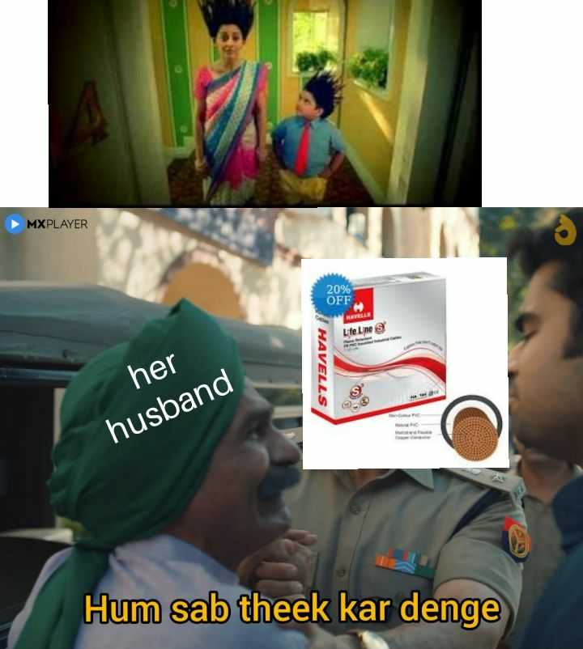
Part 4: Content Creation and Curation (Post creations, Designs/Video Editing, Ad Campaigns over Social Media and Email Ideation and Creation)
Format 3 : Creative
Title : Havells
Aim : To promote the Havells products
Date : 21st august 2023
Idea : Created a meme about Havells
Topic : Products of Havells

Slide 20
Part 4: Content Creation and Curation (Post creations, Designs/Video Editing, Ad Campaigns over Social Media and Email Ideation and Creation)
Instagram Story
Utilize the Stories feature on Instagram for three consecutive days. Share behind-the-scenes glimpses, polls, quizzes, or sneak peeks etc to encourage audience participation. Once uploaded use the story highlight feature on Instagram and save the 3 story with an appropriate name for each.
Note:
Once done monitor the performance of the posts and Stories using the insight tool and analyze the engagement metrics (likes, comments, shares, impressions, etc.). Based on the analysis, mention the strategies and areas for improvement.

Slide 21
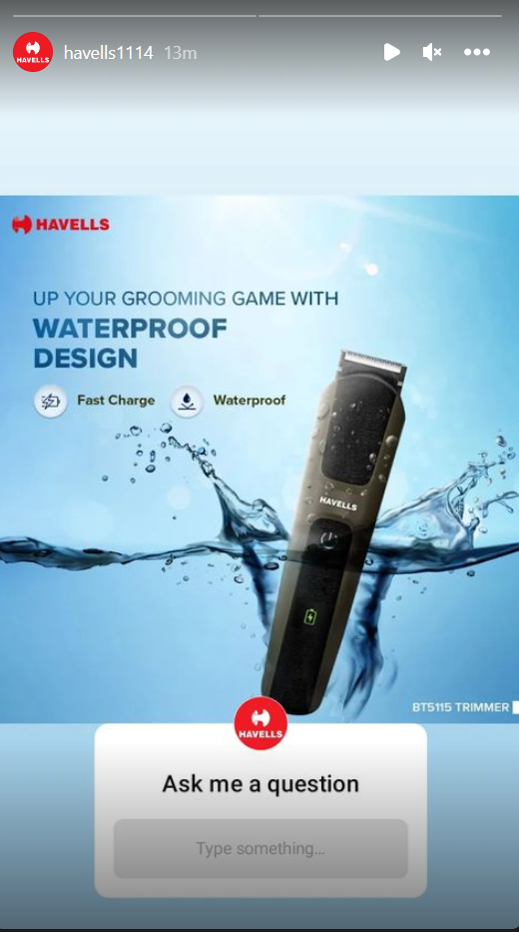
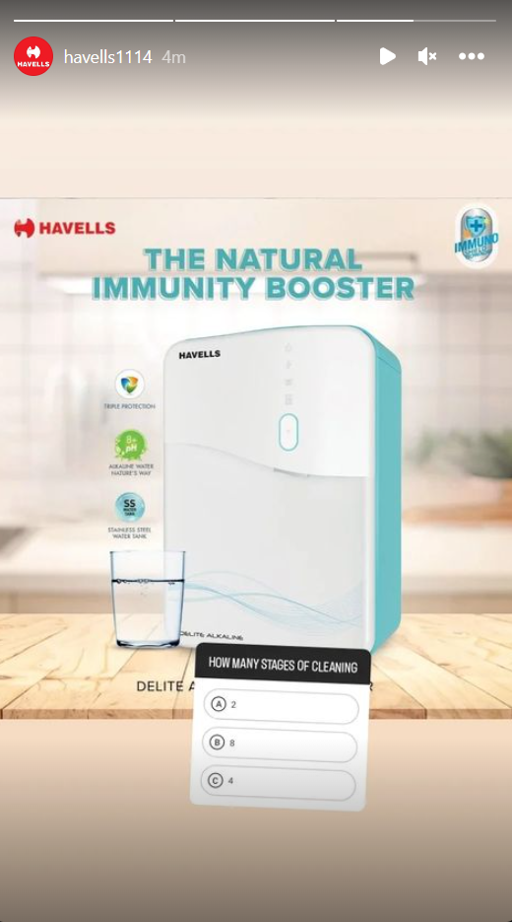
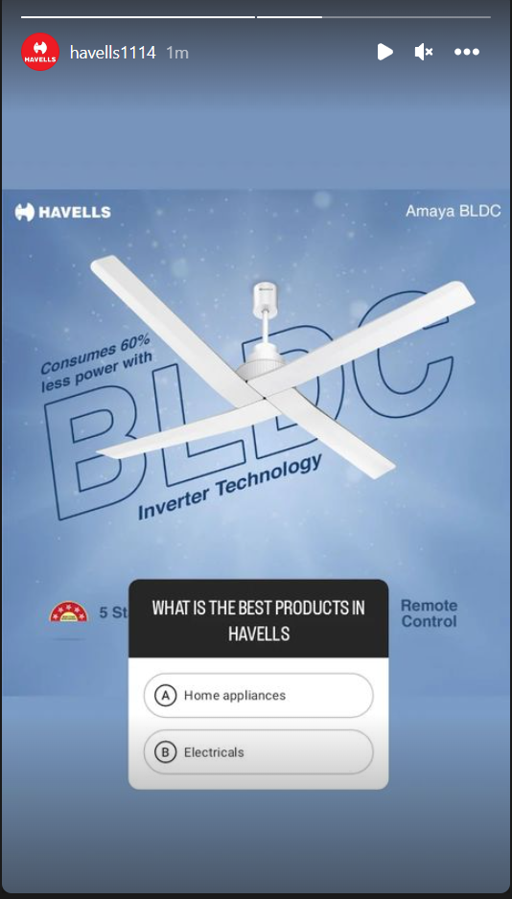
Part 4: Content Creation and Curation (Post creations, Designs/Video Editing, Ad Campaigns over Social Media and Email Ideation and Creation)
Instagram Story

Slide 22

Designs/Video Editing
Part 4: Content Creation and Curation (Post creations, Designs/Video Editing, Ad Campaigns over Social Media and Email Ideation and Creation)
Design Tools Familiarization (use Canva for creating visually appealing graphics)
Video Creation: Utilize VN or any video editor of your choice to create videos related to the
chosen topic.

Slide 23
Part 4: Content Creation and Curation (Post creations, Designs/Video Editing, Ad Campaigns over Social Media and Email Ideation and Creation)
Social Media Ad Campaigns
Ad Campaigns over Social Media:
Come up with 3 ad campaigns each covering one of the mentioned goals: brand awareness, driving website traffic, or generating leads

Slide 24
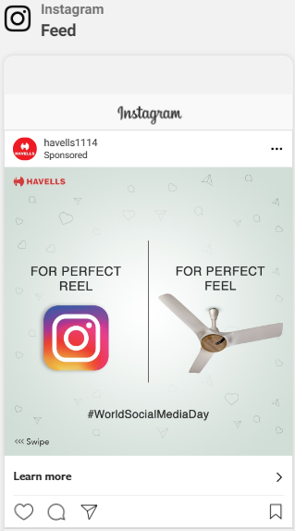
Part 4: Content Creation and Curation (Post creations, Designs/Video Editing, Ad Campaigns over Social Media and Email Ideation and Creation)
Social Media Ad Campaigns
Brand Awareness Campaign :
Targeting: Location: India, All genders,
Interests: Philips, Panasonic or LG Electronics

Slide 25
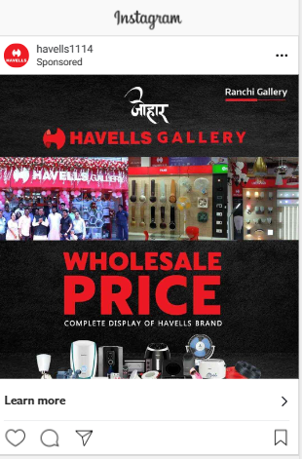
Part 4: Content Creation and Curation (Post creations, Designs/Video Editing, Ad Campaigns over Social Media and Email Ideation and Creation)
Social Media Ad Campaigns
Driving Website Traffic :
Targeting: Location: India, All genders,
Interests: Philips, Panasonic or LG Electronics

Slide 26
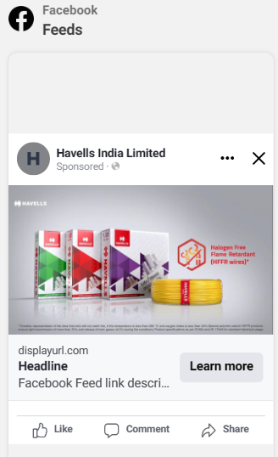
Part 4: Content Creation and Curation (Post creations, Designs/Video Editing, Ad Campaigns over Social Media and Email Ideation and Creation)
Social Media Ad Campaigns
Generating Leads :
Targeting: Location: India, All genders,
Interests: Philips, Panasonic or LG Electronics

Slide 27
Part 4: Content Creation and Curation (Post creations, Designs/Video Editing, Ad Campaigns over Social Media and Email Ideation and Creation)
For every campaign clearly define:
Advertising Goals: increasing brand awareness, driving website traffic, or generating leads.
Audience Targeting: Define the target audience for the ad campaigns based on demographics, interests, and behavior.
Ad Creation: Create visually appealing ad creatives, compelling ad copy and relevant call-to- action.

Slide 28
Part 4: Content Creation and Curation (Post creations, Designs/Video Editing, Ad Campaigns over Social Media and Email Ideation and Creation)
Email Ad Campaigns
Ad Campaigns for email marketing:
Come up with 2 email ad campaigns with the mentioned goals: brand awareness & generating leads

Slide 29
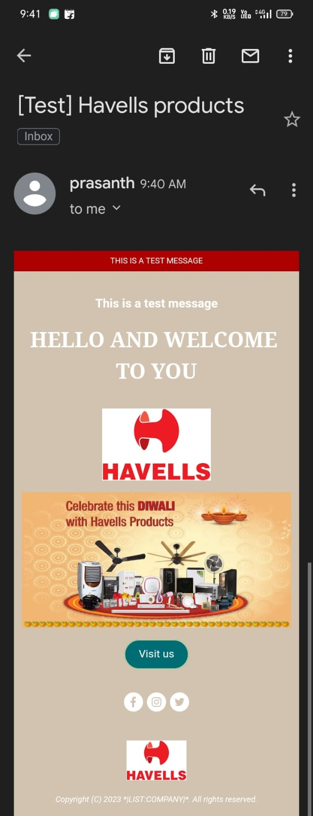
Email Ad Campaign 1 - Brand Awareness
(insert emailer image)

Slide 30
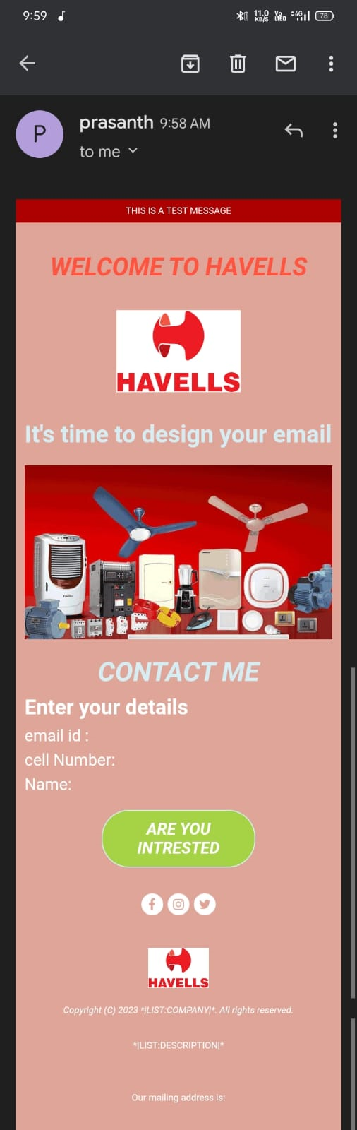
Email Ad Campaign 2 - Lead Generation
(insert emailer image)

Slide 31
Part 4: Content Creation and Curation (Post creations, Designs/Video Editing, Ad Campaigns over Social Media and Email Ideation and Creation)
Reflect on the content creation and curation process, discussing the challenges faced and
lessons learned.
1. Consistency is Key: Maintaining a consistent tone, style, and frequency of content across platforms helps reinforce brand identity and improves audience recall.
2.Visual Appeal: Eye-catching visuals, well-designed graphics, and professionally edited videos can significantly enhance the impact of content and ad campaigns.
3. A/B Testing: Regularly conducting A/B + tests for ad campaigns and email subject lines allows for data-driven optimization and better results.
4.Know our Audience: Understanding the target audience's interests, pain points, and preferences is fundamental in creating relevant and engaging content.
5. Engage with the Audience: Responding to comments, messages, and feedback from the audience fosters a sense of community and builds trust.
6. Long-Term Approach: Content creation and marketing are not one-time endeavors. A long-term, strategic approach is necessary to build brand awareness and achieve sustainable growth.
In conclusion, content creation and curation, along with thoughtful design, video editing, and well-executed ad campaigns, play a pivotal role in a successful marketing strategy. By understanding the challenges and incorporating the lessons learned, businesses can create compelling content that resonates with their target audience and drives results

